Slide 1
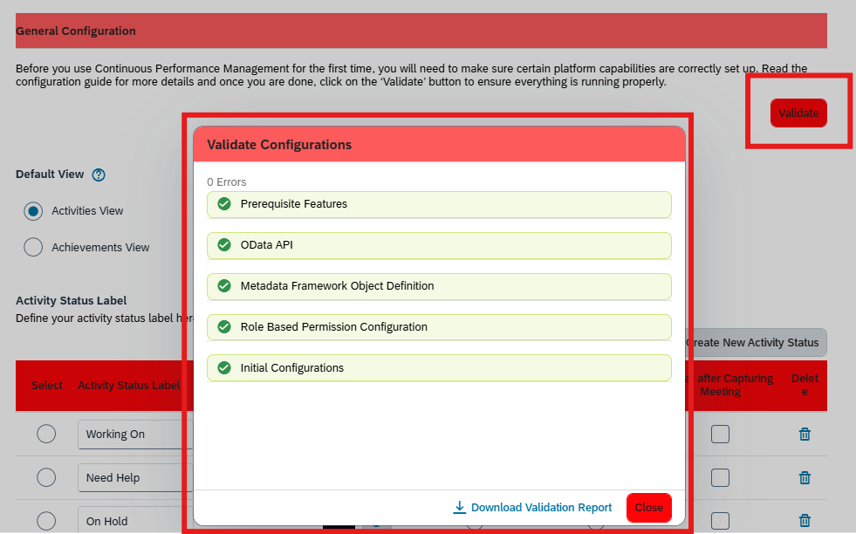
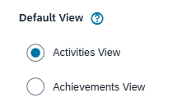
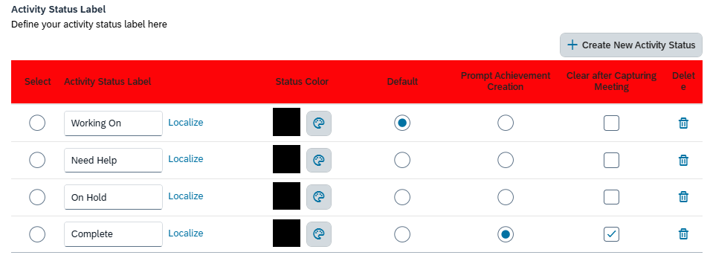
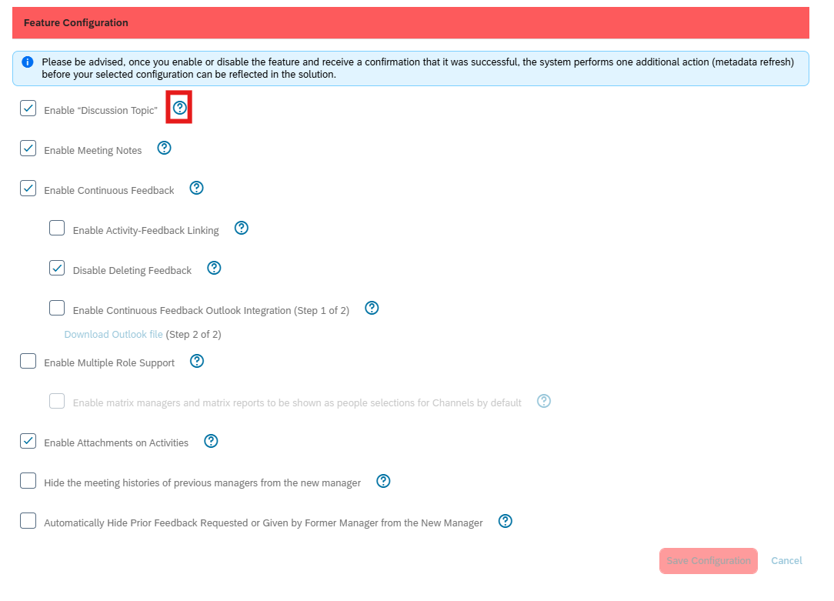
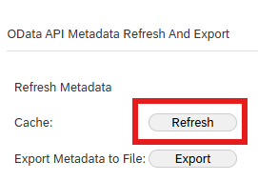
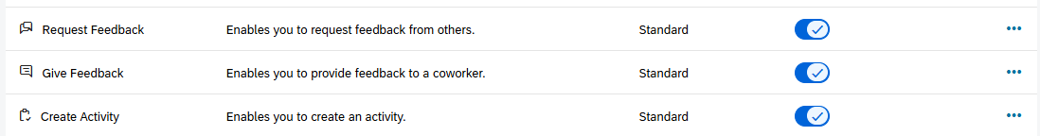
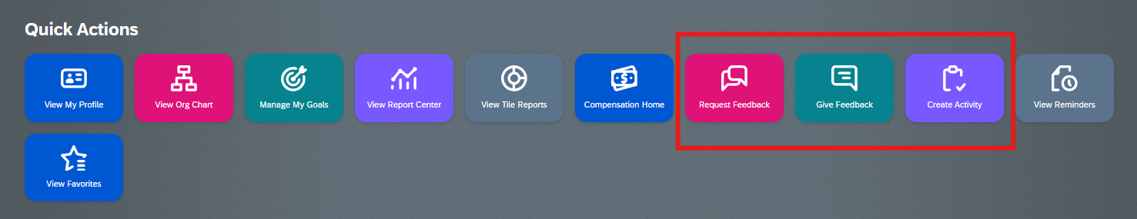
SuccessFactors: Continuous Performance Management Guide
This guide seeks to aid in the administration and configuration of the Continuous Performance Management tool and the Continuous Feedback tool.
Useful Resources:
SAP Continuous Performance Management
Continuous Performance Management Configuration:
Use this feature in SuccessFactors to configure the CPM tool and Continuous Feedback tool
General Configuration: Validate
Use the validate button to ensure the tool is running properly. For any errors that you receive, it is best to partner with Rizing to review and correct the errors. Prior to launching CPM, we should have no errors upon validation, so after launch, if configuration changes need to be made, always validate the configuration again.
Default View:
Change the default view on the CPM landing page from either the Activities View or the Achievements View
Activity Status Label:
Define the label names, status colors, and whether to prompt actions or clear the status for activities.
Changing labels mid-process will affect current CPM capabilities, so it is best to only update, create, and finalize labels prior to the launch of CPM.
Feature Configuration:
Enable unique features to customize the CPM tool further – you can review what each feature does by clicking on the question mark.
In the event you need to refresh the ODATA after enabling or disabling a feature, go to “ODATA API Metadata Refresh and Export” and Refresh the Cache.
Go back to the CPM Configuration menu and validate the configuration to ensure there are no errors.
Manage Home Page > General > Quick Actions:
Use this feature to enable the Quick Action Icons for the following tiles:
Request Feedback
Give Feedback
Create Activity
Enabling these quick action icons allows the user to quickly access feedback or create an activity for one of their performance/development goals

Slide 2
SuccessFactors: Continuous Performance Management Guide (Continued)
This guide seeks to aid in the administration and configuration of the Continuous Performance Management tool and the Continuous Feedback tool.
Useful Resources:
SAP Continuous Performance Management
RBP/User Group Access to CPM:
FL Global Administrator:
Continuous Performance User Permission:
Access to Continuous Performance Management
Access Continuous Feedback
Give Continuous Feedback
Request Feedback from others
Continuous Performance Management:
Achievement – all values
Activity – all values
Discussion Topic – all values
Manage Continuous Performance
Access to Administrative Configuration page
Admin Access Permission to all Continuous Performance Management Data
Admin Access to Delete Continuous Feedback Page
FL HR Champion:
Continuous Performance User Permission:
Access to Continuous Performance Management
Access Continuous Feedback
Give Continuous Feedback
Request Feedback from others
Continuous Performance Management:
Achievement – View | Edit only
Activity – View | Edit only
Discussion Topic – View | Edit only
FL Manager:
Continuous Performance User Permission:
Access to Continuous Performance Management
Access Continuous Feedback
Give Continuous Feedback
Request Feedback from others
Continuous Performance Management:
Achievement – View | Edit only
Activity – View | Edit only
Discussion Topic – View | Edit only | View Pending Approvals | Review Pending Approvals
FL Employee (Self View)
Continuous Performance User Permission:
Access to Continuous Performance Management
Access Continuous Feedback
Give Continuous Feedback
Request Feedback from others
Limit about whom feedback can be requested
Continuous Performance Management:
Achievement – View | Edit only
Activity – View | Edit only
Discussion Topic – View | Edit only
FL GMPM Admin:
Continuous Performance User Permission:
Access to Continuous Performance Management
Access Continuous Feedback
Give Continuous Feedback
Request Feedback from others
Continuous Performance Management:
Achievement – all values
Activity – all values
Discussion Topic – all values
Manage Continuous Performance
Admin Access Permission to all Continuous Performance Management Data
Admin Access to Delete Continuous Feedback Page

